Slide 1
LECTURE 05 Relation

Slide 2
What you will learn in this lecture:
Cartesian products
Binary Relations
Inverse of Relations
Composition of Relations
Equivalence Relation
Partial Ordering Relation

Slide 3
Introduction
Relationship between elements of sets occur in many contexts. For example a relationship of a person and their country origin which can be described as “x is a citizen of y”, where x is from the set of people and y is from the set of countries.
Relationships between elements of sets are represented using the structure called a relation, which is just a subset of the Cartesian product of the sets.

Slide 4
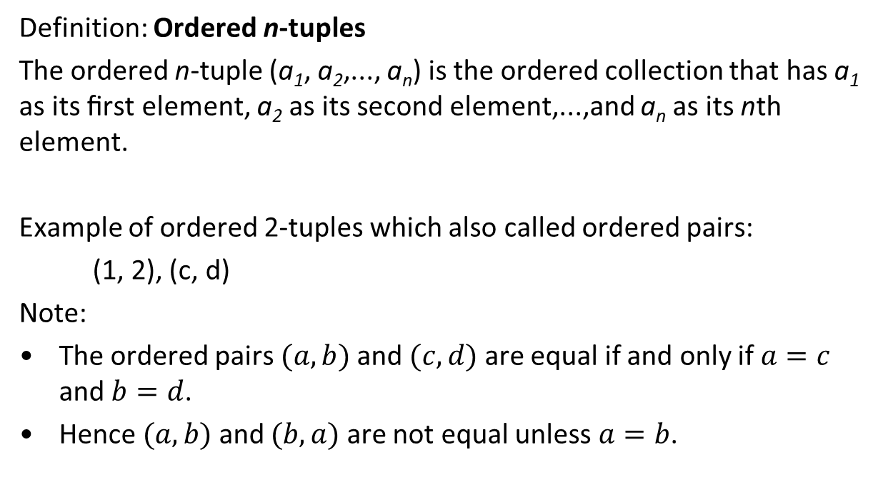
Cartesian products
Definition: Ordered n-tuples
The ordered n-tuple (a₁, a₂,..., a_{n}) is the ordered collection that has a₁ as its ﬁrst element, a₂ as its second element,...,and a_{n} as its nth element.
Example of ordered 2-tuples which also called ordered pairs:
(1, 2), (c, d)
Note:
The ordered pairs $(a,b)$ and $(c,d)$ are equal if and only if $a=c$ and $b=d$.
Hence $(a,b)$ and $(b,a)$ are not equal unless$a=b$.

Slide 5
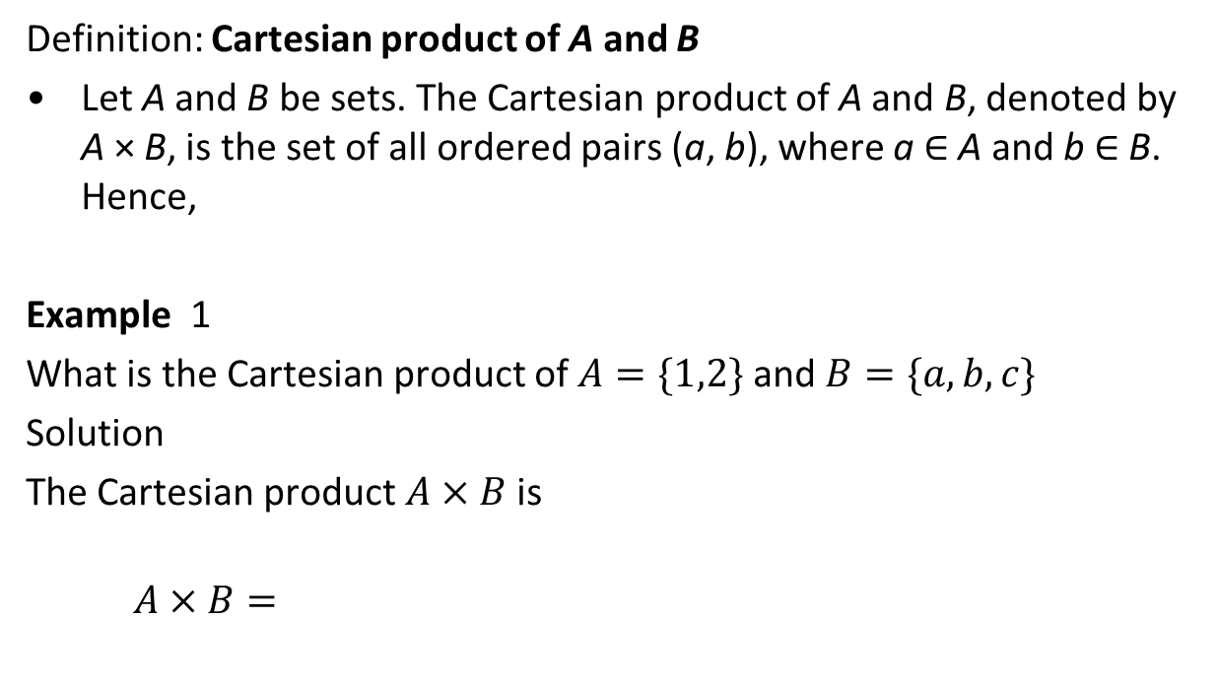
Cartesian products
Definition: Cartesian product of A and B
Let A and B be sets. The Cartesian product of A and B, denoted by A × B, is the set of all ordered pairs (a, b), where a ∈ A and b ∈ B. Hence,
Example 1
What is the Cartesian product of $A=\{1,2\}$ and $B=\{a,b,c\}$
Solution
The Cartesian product $A×B$ is
$$A×B=$$

Slide 6
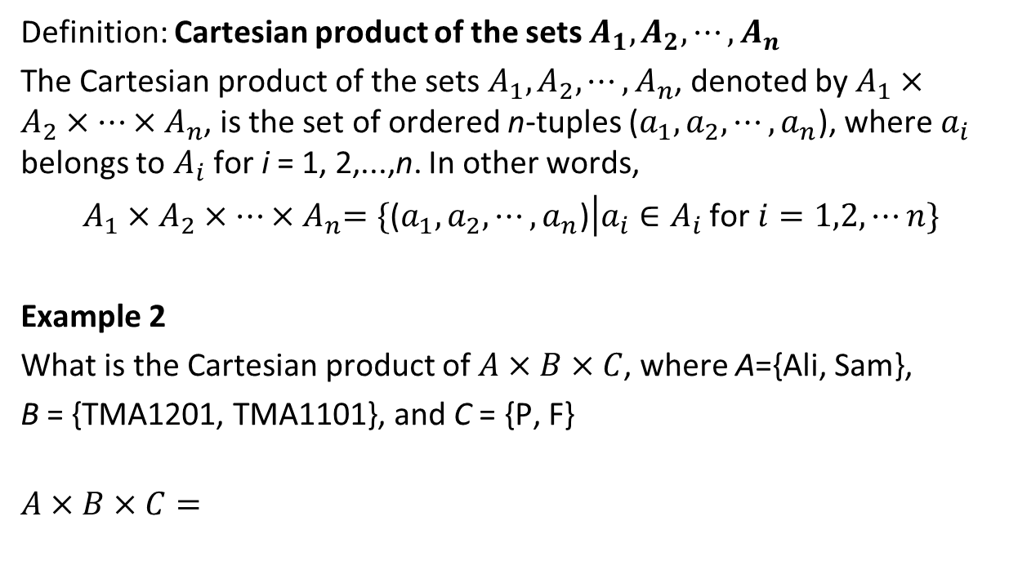
Cartesian products
Definition: Cartesian product of the sets $A_{1},A_{2},⋯,A_{n}$
The Cartesian product of the sets $A_{1},A_{2},⋯,A_{n}$, denoted by $A_{1}×A_{2}×⋯{×A}_{n}$, is the set of ordered n-tuples ($a_{1},a_{2},⋯,a_{n}$), where $a_{i}$ belongs to $A_{i}$ for i = 1, 2,...,n. In other words,
$A_{1}×A_{2}×⋯{×A}_{n}=\{\text{(}a_{1},a_{2},⋯,a_{n}\text{)}\left|a_{i}∈A_{i}\right.$ for $i=1,2,⋯n\}$
Example 2
What is the Cartesian product of $A×B×C$, where A={Ali, Sam},
B = {TMA1201, TMA1101}, and C = {P, F}
$$A×B×C=$$

Slide 7
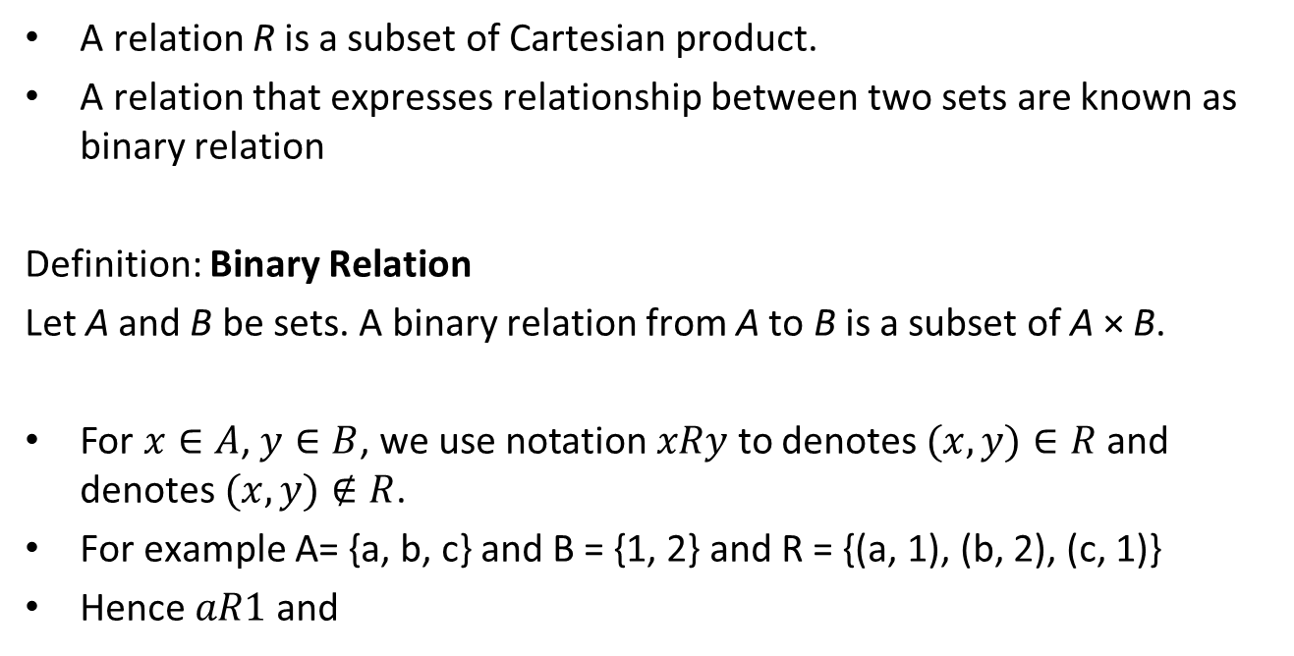
Representation of Relation
A relation R is a subset of Cartesian product.
A relation that expresses relationship between two sets are known as binary relation
Definition: Binary Relation
Let A and B be sets. A binary relation from A to B is a subset of A × B.
For $x∈A$, $y∈B$, we use notation $xRy$ to denotes $(x,y)∈R$ and denotes $(x,y)∉R$.
For example A= {a, b, c} and B = {1, 2} and R = {(a, 1), (b, 2), (c, 1)}
Hence $aR1$ and

Slide 8

Example 3
Suppose A be set of students, B be subjects offered by FCI and R denotes the enrollment of students from A to subjects B. For simplicity let A = {Ali, Sam}, B = {Maths, Eng, CP} and
R={(Ali, Maths), (Ali Eng), (Sam, Eng), (Sam, CP)}.
Cartesian Product
R
Ali
Sam
Maths
Eng
CP
Ali
Sam
Maths
Eng
CP
$$⊇$$

Slide 9
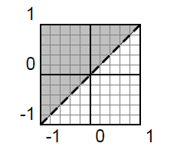
Example 4
Let S be the relation “<“ on the real number set.
The set of S thus consists of all the pairs (x, y) with x < y. It is the following
shaded subset of the xy plane.
(The dashed line indicates that the points where x = y are omitted.)
Note: order is important in this relation, e.g., 1S2 but 2S1

Slide 10

Inverse of a Relation
If R is a relation from set A to set B, the inverse of a relation denoted as R⁻¹ can be defined to be a relation from set B to set A.
R⁻¹ can be found by interchanging the elements of all ordered pairs.
Its mathematical definition is as below:
Note: A and B can be a similar set or a different set

Slide 11
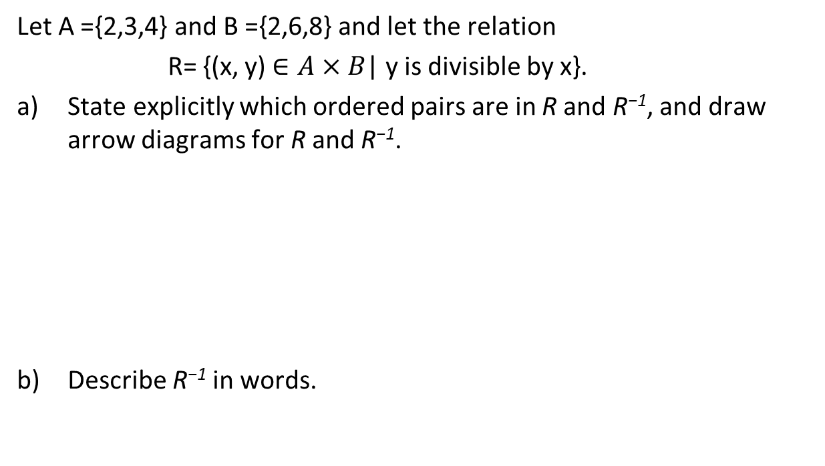
Example
Let A ={2,3,4} and B ={2,6,8} and let the relation
R= {(x, y) $∈A×B$| y is divisible by x}.
a) State explicitly which ordered pairs are in R and R⁻¹, and draw arrow diagrams for R and R⁻¹.
b) Describe R⁻¹ in words.

Slide 12
Example 4
List the elements of below:
Let R₂ be the relation define on the set of integers and R₂ = {(n, m) | n < m}
List down the elements of R₂
R₂ =
List down the elements of R₂⁻¹
R₂⁻¹ =
Write the definition of R₂⁻¹

Slide 13
Composition of Relations
Objects in a set can comprise of more than one relation.
The composition of relations is denoted by the symbol □
S □ R = {(a, c) | there exist b∈B where aRb and bSc} is called the composite of R ⊆ A×B and S ⊆ B×C.

Slide 14
Example 5
Let R and S be relations on the set {0,1,2,3,4} and
R = {(1, 1), (1, 4), (2, 3), (3, 1), (3, 4)}
S = {(1, 0), (2, 0), (3, 1), (3, 2), (4, 1)}
Find R ο S, S ο R.
Solution:
S □ R = {(1, 0), (1, 1), (2, 1), (2, 2), (3, 0), (3, 1)}
R □ S = {(3, 1), (3, 4), (3, 3), (4, 1), (4, 4)}
How will these looks like in the form of arrow diagram?

Slide 15
Example 6
Given R = { (1, 3), (2, 6), (3, 2), (2,7)} on the set A={1, 2, 3, 4, 5, 6, 7}.
Find R², R³, R⁴, R⁵, and R⁶.
Solution:
R² = R □ R = {(1, 2), (3, 6), (3, 7)}
R³ = R² □ R =
R⁴ = R³ □ R =
R⁵ = R⁴ □ R =
R⁶ = R⁵ □ R =

Slide 16
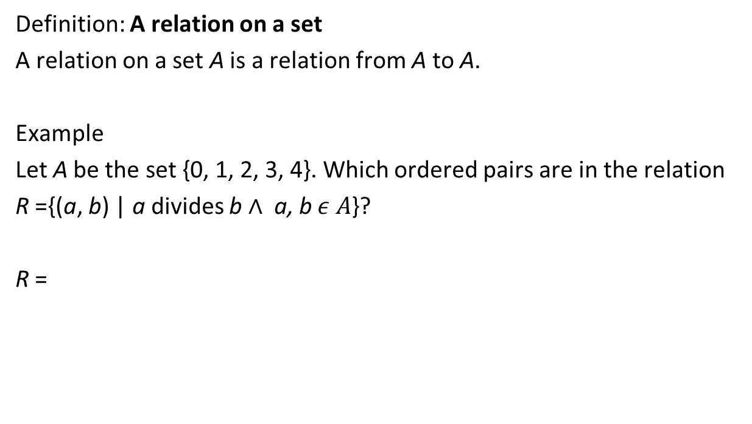
Relation on a Set
Definition: A relation on a set
A relation on a set A is a relation from A to A.
Example
Let A be the set {0, 1, 2, 3, 4}. Which ordered pairs are in the relation
R ={(a, b) | a divides b $∧$ a, b $ε A$}?
R =

Slide 17
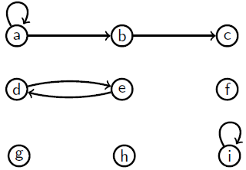
Arrow Diagrams for Relation
Relation can be represented with arrow diagrams.
Example 7
Let R be the relation on set {a, b, c, d, e, f, g, h, i} and R = {(a, a), (a, b), (b, c), (d, e), (e, d), (i, i)}. The arrow diagram of R is as the following:

Slide 18
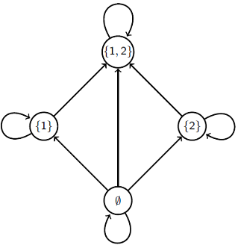
Example 8
Write the set of ordered pairs for the relation on P({1, 2}) and draw an arrow diagram for it.
Solution:
P({1, 2}) = {∅, {1}, {2}, {1, 2}}.
{(∅, ∅), (∅, {1}), (∅, {2}), (∅, {1, 2}), ({1}, {1}), ({1}, {1, 2}), ({2}, {2}),
({2}, {1, 2}), ({1, 2}, {1, 2})}

Slide 19
Properties of relation
A relation R defined on a set A has these properties,
REFLEXIVE
↔ For all a ∈ A , (a, a) ∈ R
SYMMETRIC
↔ For all a, b ∈ A, If (a, b) ∈ R then (b, a) ∈ R
ANTISYMMETRIC
For all a, b ∈ A and a ≠ b, If (a, b) ∈ R then (b, a) R
TRANSITIVE
↔ For all a, b, c ∈ A, If (a, b) ∈ R and (b, c) ∈ R then (a, c) ∈ R

Slide 20
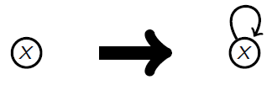
Reflexive (For a binary relation R on a set A)
Think about it as...
To prove R is reflexive, show that “For all x A, xRx”.
To prove R is not reflexive, show that “There is an x A such that xRx.

Slide 21
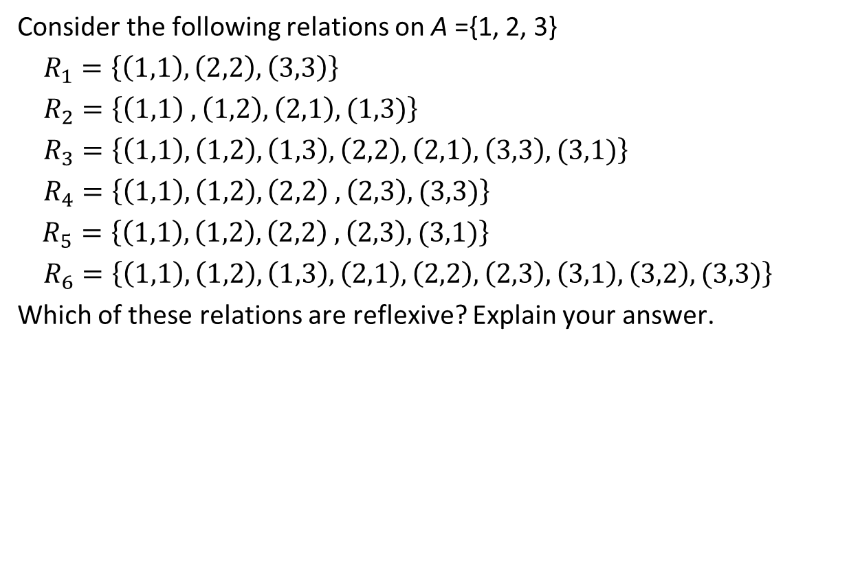
Example 9
Consider the following relations on A ={1, 2, 3}
$R_{1}=\left\{\left(1,1\right),\left(2,2\right),\left(3,3\right)\right\}$
$R_{2}=\left\{\left(1,1\right) ,\left(1,2\right),\left(2,1\right),(1,3)\right\}$
$R_{3}=\left\{\left(1,1\right),\left(1,2\right), \left(1,3\right),\left(2,2\right),\left(2,1\right),\left(3,3\right),(3,1)\right\}$
$R_{4}=\left\{\left(1,1\right),\left(1,2\right),\left(2,2\right) ,\left(2,3\right),(3,3)\right\}$
$R_{5}=\left\{\left(1,1\right),\left(1,2\right),\left(2,2\right) ,\left(2,3\right),(3,1)\right\}$
$R_{6}=\left\{\left(1,1\right),\left(1,2\right),\left(1,3\right),\left(2,1\right),\left(2,2\right), \left(2,3\right),\left(3,1\right),\left(3,2\right),(3,3)\right\}$
Which of these relations are reflexive? Explain your answer.

Slide 24
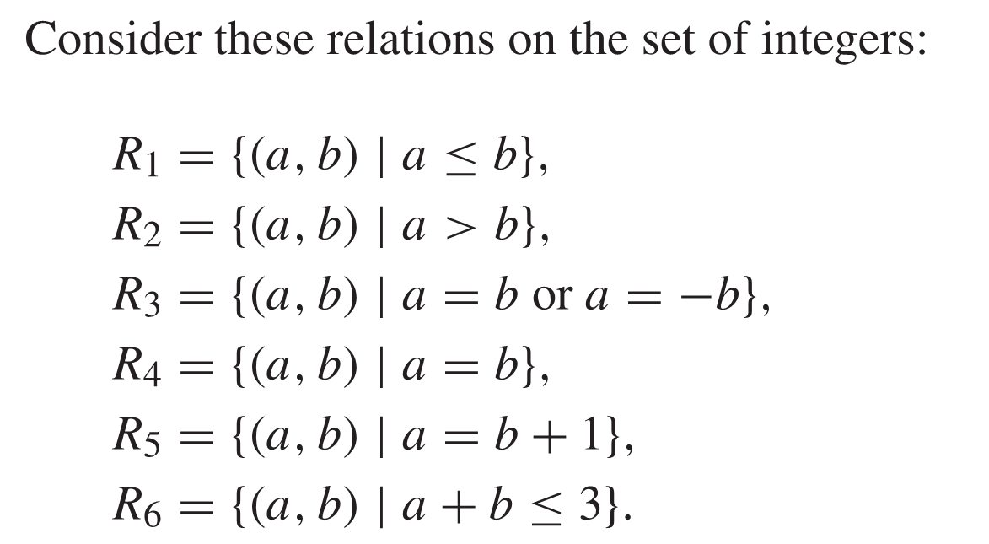
Example 10
Which of these relations are reflexive?

Slide 27
Symmetric (For a binary relation R on a set A)
Think about it as...
To prove R is symmetric, show that “For all x, y A, if xRy then yRx”.
To prove R is not symmetric, show that “There are some x, y A such that xRy but yRx.

Slide 28
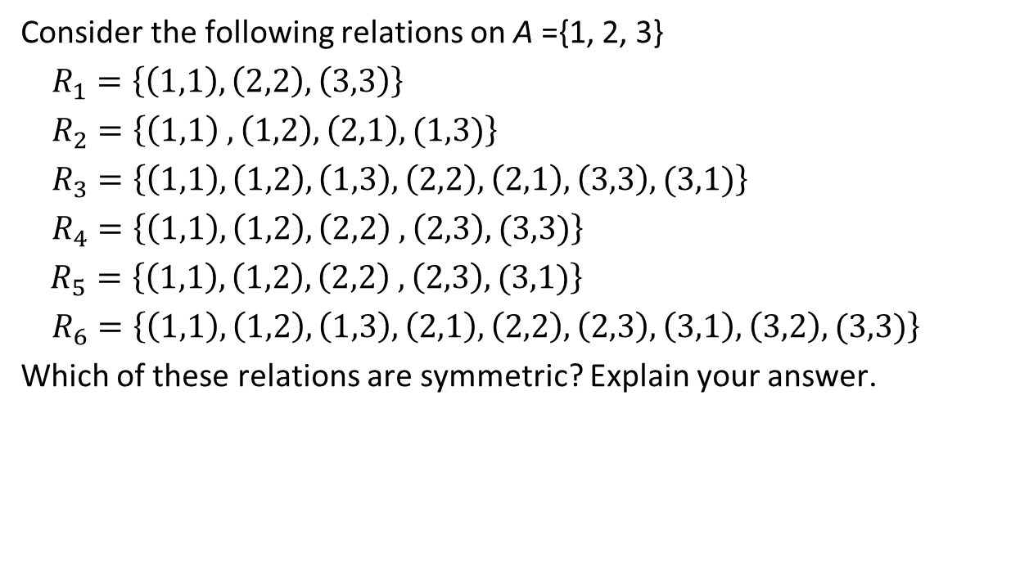
Example 11
Consider the following relations on A ={1, 2, 3}
$R_{1}=\left\{\left(1,1\right),\left(2,2\right),\left(3,3\right)\right\}$
$R_{2}=\left\{\left(1,1\right) ,\left(1,2\right),\left(2,1\right),(1,3)\right\}$
$R_{3}=\left\{\left(1,1\right),\left(1,2\right), \left(1,3\right),\left(2,2\right),\left(2,1\right),\left(3,3\right),(3,1)\right\}$
$R_{4}=\left\{\left(1,1\right),\left(1,2\right),\left(2,2\right) ,\left(2,3\right),(3,3)\right\}$
$R_{5}=\left\{\left(1,1\right),\left(1,2\right),\left(2,2\right) ,\left(2,3\right),(3,1)\right\}$
$R_{6}=\left\{\left(1,1\right),\left(1,2\right),\left(1,3\right),\left(2,1\right),\left(2,2\right), \left(2,3\right),\left(3,1\right),\left(3,2\right),(3,3)\right\}$
Which of these relations are symmetric? Explain your answer.

Slide 31
Example 12
Which of the relations are symmetric?

Slide 34
Antisymmetric
(For a binary relation R on a set A)
Think about it as...
To prove R is antisymmetric, show that “For all x, y A, if xRy and yRx then x = y”.
To prove R is not antisymmetric, show that “There are some x, y A such that x ≠ y, xRy and yRx.

Slide 35
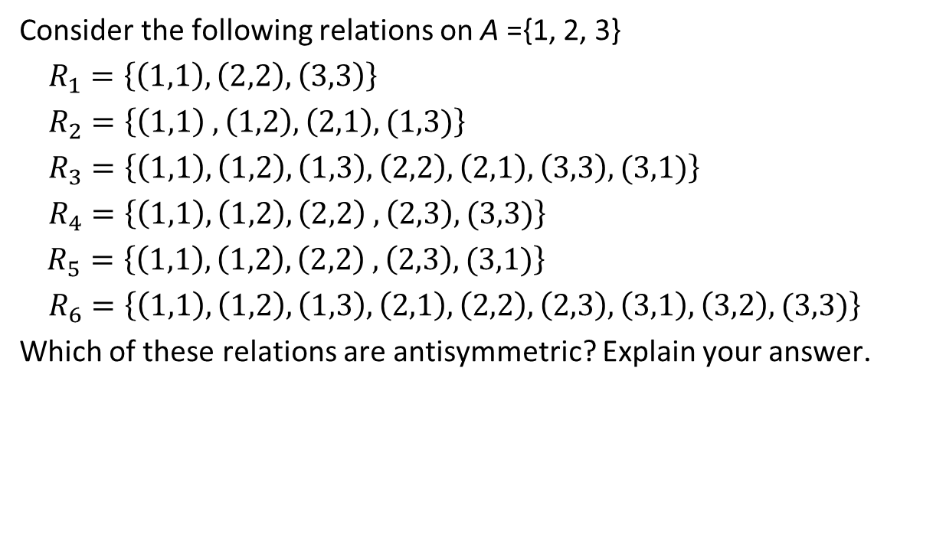
Example 13
Consider the following relations on A ={1, 2, 3}
$R_{1}=\left\{\left(1,1\right),\left(2,2\right),\left(3,3\right)\right\}$
$R_{2}=\left\{\left(1,1\right) ,\left(1,2\right),\left(2,1\right),(1,3)\right\}$
$R_{3}=\left\{\left(1,1\right),\left(1,2\right), \left(1,3\right),\left(2,2\right),\left(2,1\right),\left(3,3\right),(3,1)\right\}$
$R_{4}=\left\{\left(1,1\right),\left(1,2\right),\left(2,2\right) ,\left(2,3\right),(3,3)\right\}$
$R_{5}=\left\{\left(1,1\right),\left(1,2\right),\left(2,2\right) ,\left(2,3\right),(3,1)\right\}$
$R_{6}=\left\{\left(1,1\right),\left(1,2\right),\left(1,3\right),\left(2,1\right),\left(2,2\right), \left(2,3\right),\left(3,1\right),\left(3,2\right),(3,3)\right\}$
Which of these relations are antisymmetric? Explain your answer.

Slide 38
Example 14
Which of the relations are antisymmetric?

Slide 41

Transitive (For a binary relation R on a set A)
Think about it as...
To prove R is transitive, show that “For all x, y, z A, if xRy and yRz then xRz”.
To prove R is not transitive, show that “There are some x, y, z A such that xRy and yRz but xRz”.

Slide 42
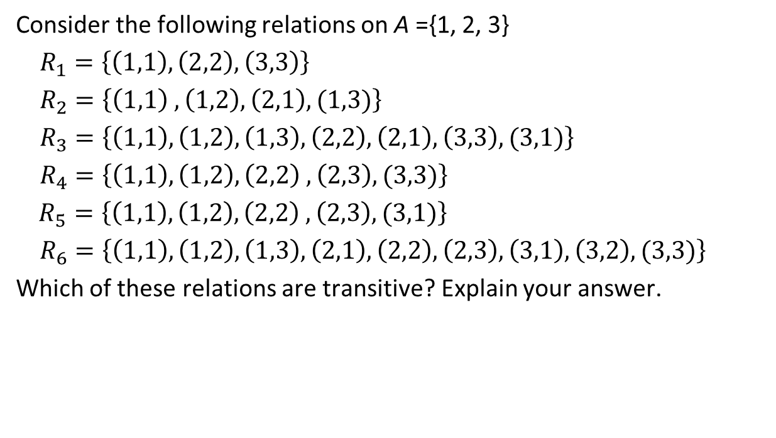
Example 15
Consider the following relations on A ={1, 2, 3}
$R_{1}=\left\{\left(1,1\right),\left(2,2\right),\left(3,3\right)\right\}$
$R_{2}=\left\{\left(1,1\right) ,\left(1,2\right),\left(2,1\right),(1,3)\right\}$
$R_{3}=\left\{\left(1,1\right),\left(1,2\right), \left(1,3\right),\left(2,2\right),\left(2,1\right),\left(3,3\right),(3,1)\right\}$
$R_{4}=\left\{\left(1,1\right),\left(1,2\right),\left(2,2\right) ,\left(2,3\right),(3,3)\right\}$
$R_{5}=\left\{\left(1,1\right),\left(1,2\right),\left(2,2\right) ,\left(2,3\right),(3,1)\right\}$
$R_{6}=\left\{\left(1,1\right),\left(1,2\right),\left(1,3\right),\left(2,1\right),\left(2,2\right), \left(2,3\right),\left(3,1\right),\left(3,2\right),(3,3)\right\}$
Which of these relations are transitive? Explain your answer.

Slide 45
Example 16
Which of the relations are transitive?

Slide 48
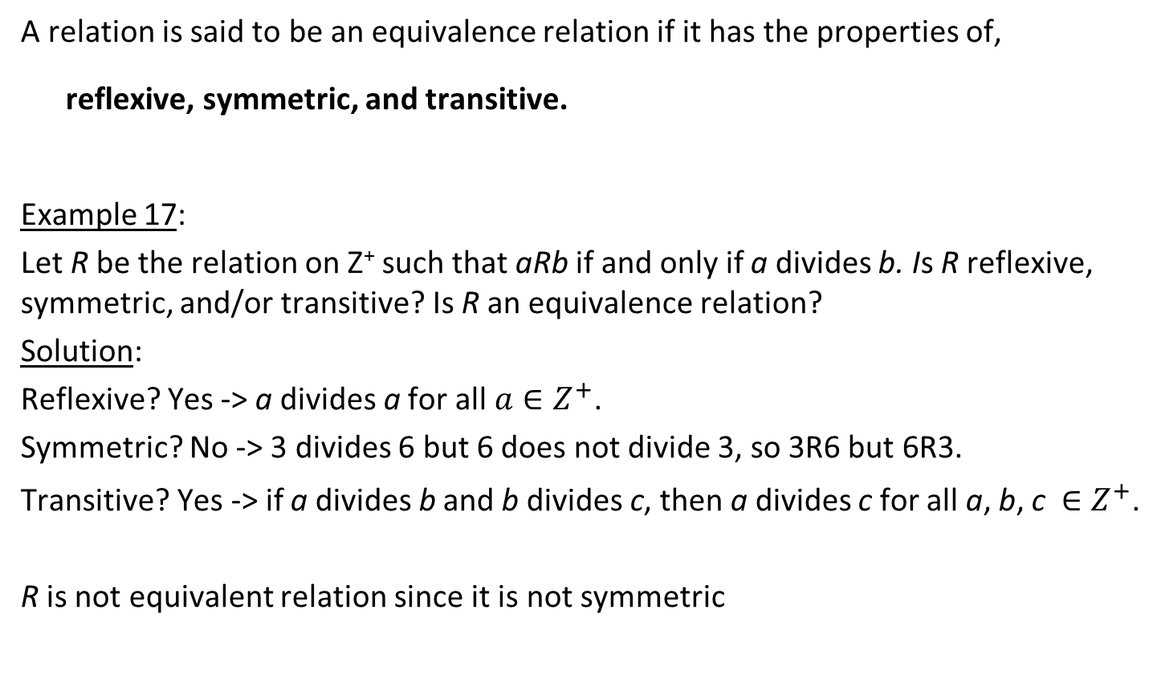
Equivalence Relation
A relation is said to be an equivalence relation if it has the properties of,
reflexive, symmetric, and transitive.
Example 17:
Let R be the relation on Z⁺ such that aRb if and only if a divides b. Is R reflexive, symmetric, and/or transitive? Is R an equivalence relation?
Solution:
Reflexive? Yes -> a divides a for all $a∈Z^{+}$.
Symmetric? No -> 3 divides 6 but 6 does not divide 3, so 3R6 but 6R3.
Transitive? Yes -> if a divides b and b divides c, then a divides c for all a, b, c $∈Z^{+}$.
R is not equivalent relation since it is not symmetric

Slide 49
Example 18
Is the relation “5 divides (x – y)” an equivalence relation on Z?

Slide 50
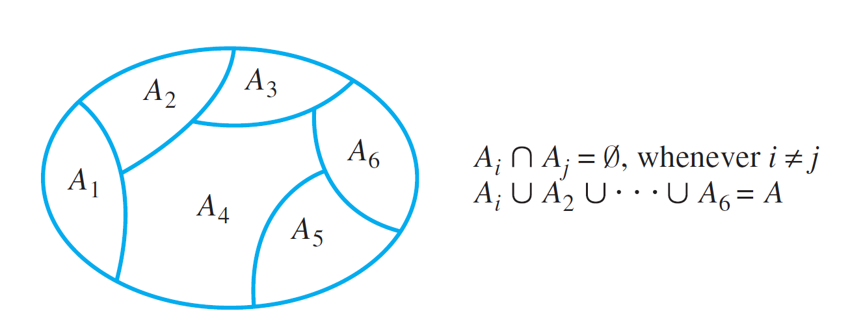
Equivalence Class
Giving an equivalence relation on a nonempty set is equivalent to partitioning the set into many subsets {A₁, A₂, … } with the following requirements:
A_{i} ≠ ∅ for each i
A_{i}’s are mutually disjoint, i.e. A_{i} ∩ A_{j} = ∅ for i ≠ j, and
A = ∪ A_{n}.
Example:
A₁, A₂, A₃, A₄, A₅, A₆ are called the equivalence classes.

Slide 51
Equivalence Class
There are 5 equivalence classes for the equivalence relation
5 divides x – y on the set Z:
{..., -10, -5, 0, 5, 10, ...}
{..., -9, -4, 1, 6, 11, ...}
{..., -8, -3, 2, 7, 12, ...}
{..., -7, -2, 3, 8, 13, ...}
{..., -6, -1, 4, 9, 14, ...}

Slide 52
Partial Ordering Relation
A relation is said to be a partial order if it has the properties of, reflexive, anti-symmetric, and transitive. The ordered pair objects in R is called a poset . A partial order set can indicate that for certain pairs of elements in the set, one of the element is of higher order than the other. An example is the pre-requisite subjects that is imposed on a student’s study plan at a university.

Slide 53
Example 19
Given,
R = {(i, j) | i divides j},
where i, j ∈ Z⁺
Determine if R is a partial order.
Solution:
Check the followings:
is it reflexive?
is it antisymmetric?
is it transitive?
Make sure that you are able to explain the answer based on the definition of the properties!

Slide 54
An Example of n-ary Relation:
Assuming that MMU students’ attendance database contains the following:
A₁ be a set of positive integers for student ID
A₂ a set of alphabetic character strings for name
A₃ a set of numeric character strings for date of attendance for a subject
A₄ a set of logical character T for “attended” and F for “absence” for indicating attendance
Assume that a student, “Tanpa Nama” wishes to retrieve his attendance detail for a particular date. The data that will be retrieved can be in the following form:
(100000001, Tanpa Nama, 250612, T)
Student ID
Name
Date
Attendance Indicator

Slide 55
For this particular example, the relation is known as a quaternary relation R on the sets A₁, A₂, A₃, A_{4,} where:
(a₁, a₂, a₃, a₄) ∈ R
⇔ a student with student ID number a₁, named a₂, date of attendance a₃, with attendance info a₄.
The elements of set R above may contain those of below:
{(100000011, No Name, 250612, F),
(100000111, Namaewa Iie, 250612, T), …}

Slide 56
Summary
We have learnt the following concepts related to relations:
Relations occur in a set and may involve two or more sets.
Relations are a subset of Cartesian products.
Relations have inverse and can form composition.
Relations may have none/any/all of the following properties:
reflexive, symmetric, antisymmetric, transitive.
An equivalence relation has the properties reflexive, symmetric and transitive.
A partial order has the properties reflexive, antisymmetric and transitive.

Slide 57
Exercise 1
What is the difference between {a, b, c} and (a, b, c)? Explain.

Slide 58
Exercise 2
Give the set of ordered pairs for the relation ≤ on the set {1, 2, 3, 4, 5, 6}. Draw an arrow diagram to illustrate the relationship between elements in the set.

Slide 59
Exercise 3
Given,
R₁ = {(x, y) | x and y are human beings and x is taller than y}
R₂ = {(x, y) | x and y are human beings, and both have the same height}
R₃ = {(a, b) | |a – b| ≤ 4}, where a, b ∈ Ζ
R₄ = {(a, b) | (a – b) is a multiple of 7}, where a, b ∈ Ζ
Determine if each of these are equivalence relation. Justify your answer.
Determine if each of these are partial order. Justify your answer.

